Slide 1
Ecalendar
Team Members
Aravind
Akshay
Keerthi
Poojitha
Sree Chandra

Slide 2
INTRODUCTION
The E-Calendar System allows user login, event management,and provides realtime visibility with interactive data visualization on a centralized calendar.

Slide 3
PROBLEM STATEMENT
Managing employee schedules, leaves manually takes a lot of time and effort, often leading to mistakes and miscommunication.
Managers have to track everything manually, updating records which can be frustrating and inefficient.
There is a need for an automated system which provides seamless attendance tracking and data visualization for better decision making.

Slide 4
TECHNOLOGIES
Java
Spring Boot
React
MySQL

Slide 5
OBJECTIVES AND GOALS
Develop a user-friendly system for employee and manager login.
Allow managers to add, view, and manage schedules for a day, week, month, or year.
Enable managers to track employee leave data with bar chart visualization.
Ensure real-time updates and accessibility for efficient scheduling.
Provide employees with a clear view of attendance trends..

Slide 6
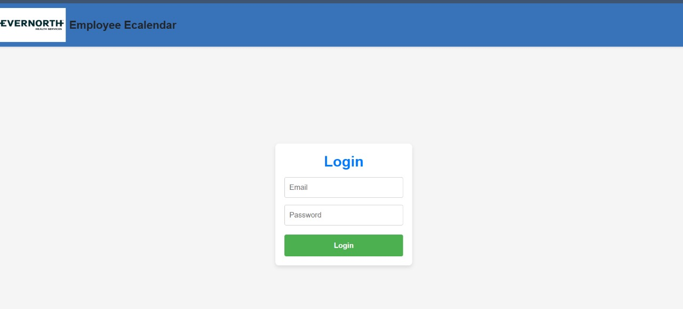
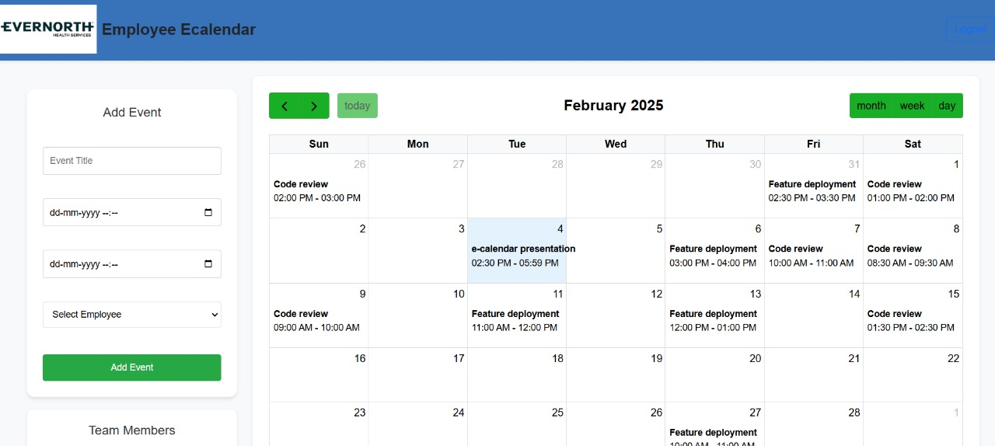
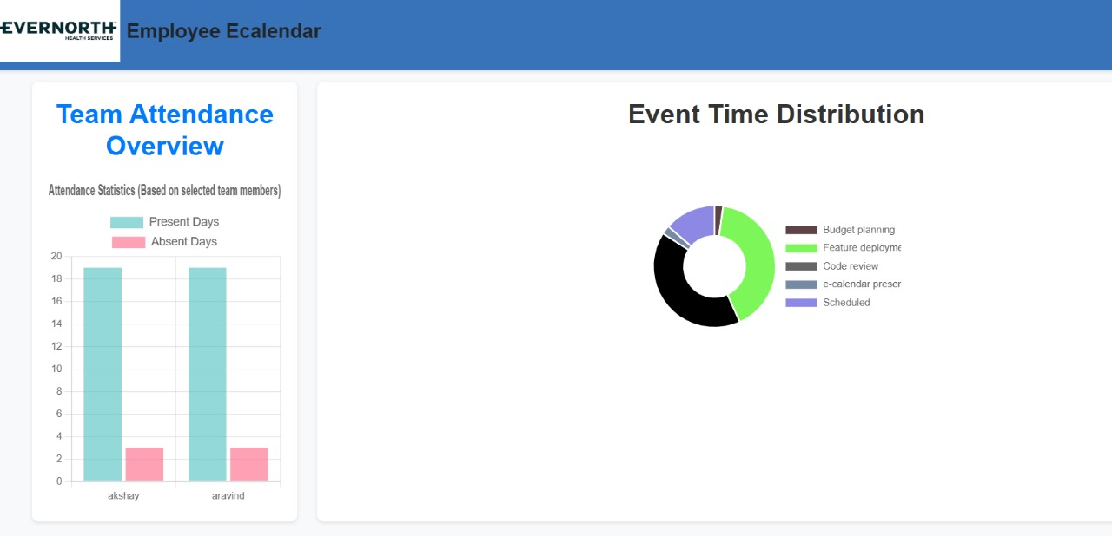
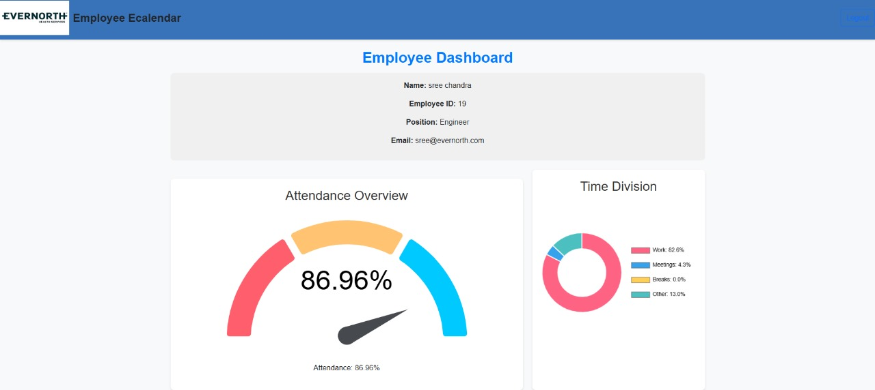

Slide 7
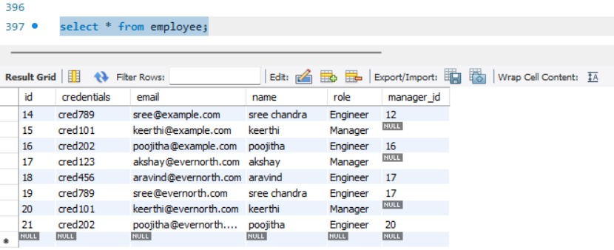
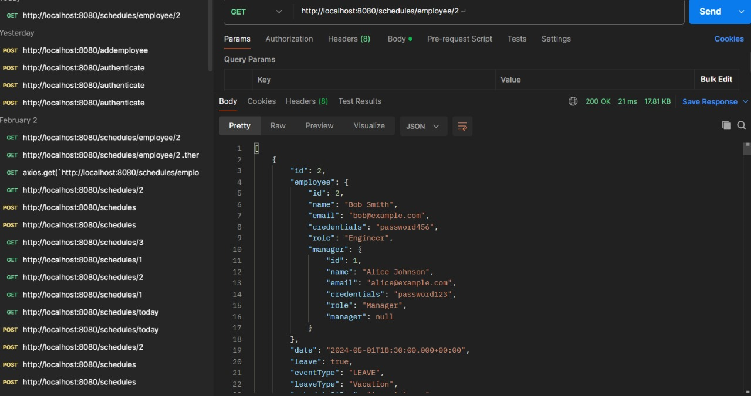

Slide 8

Conclusion
Automates scheduling, leave management, and attendance tracking.
Enhances efficiency with real-time updates and secure access.

Slide 9
Thankyou

